Slide 1
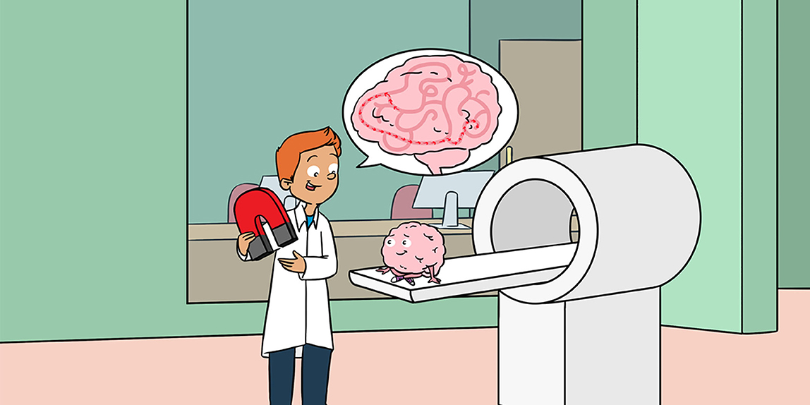
fMRI Analysis Workshop
Levy Decision Neuroscience Lab
Harpaz-Rotem PTSD Treatment & Research Lab
Ziv Ben-Zion
Feb 28, 2024

Slide 2
Outline
PTSD Subtyping Study – fMRI design & initial results
fMRI Analysis Pipeline – from raw DCM files to activation maps
Functional Connectivity Analysis – CONN toolbox
Discussion / Q&A / Other Cool Stuff

Slide 3
Part 1:
PTSD Subtyping Study -
fMRI design & results

Slide 4





Characterization of PTSD Subpopulations Towards Precision Psychiatry
Online Study (n=2000): Stratification of Patients vis Online Questionnaires: Fear vs. Emotional Pain/Rumination (cognitive bias) – V Completed
fMRI & MEG Study (n=72): A pilot study with the defined PTSD subgroups to explore differences in neural patterns – V Ongoing

Slide 5
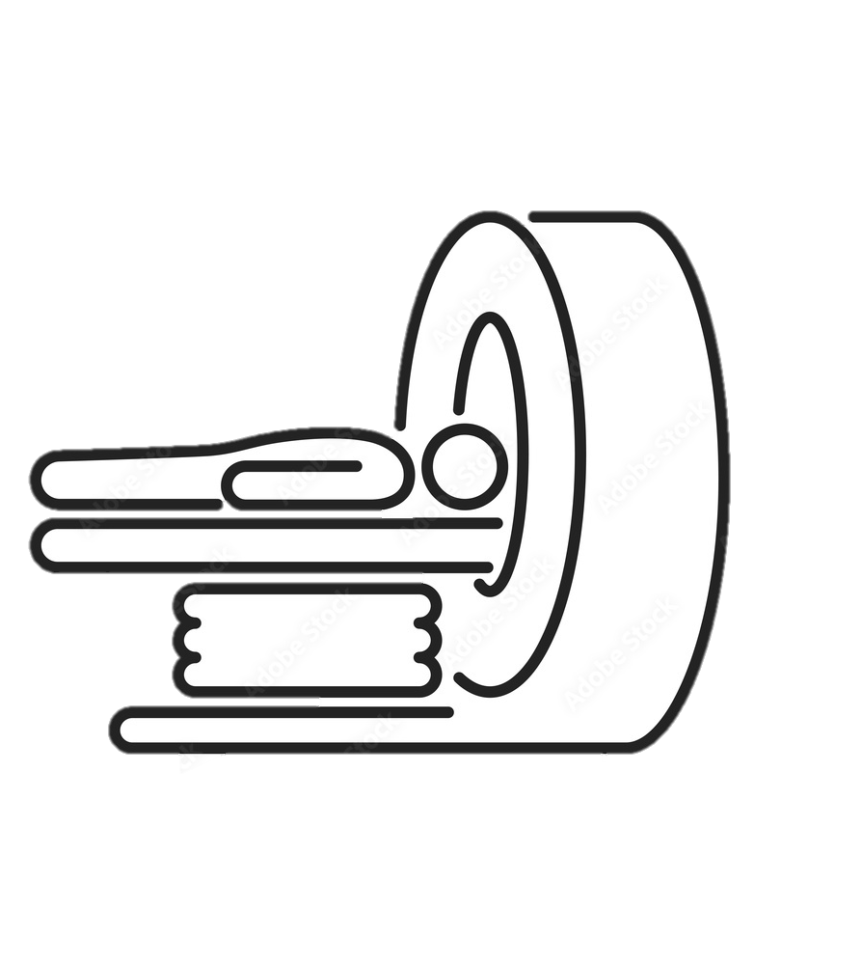

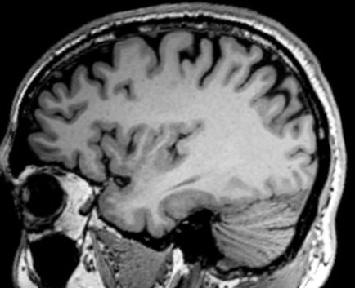

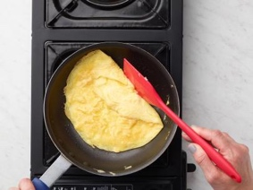

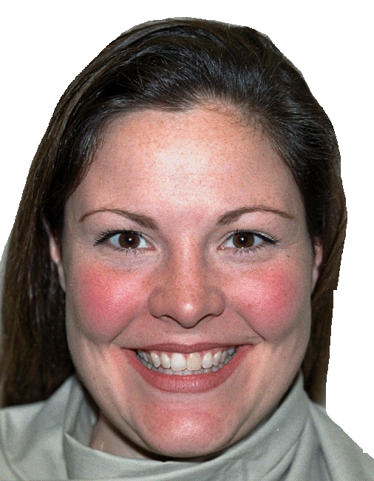


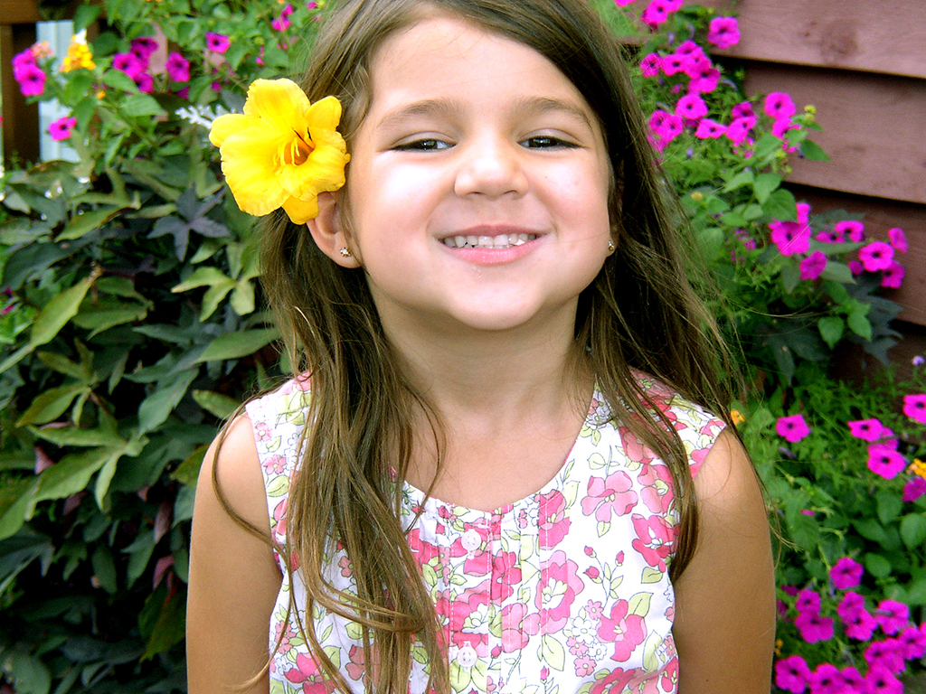
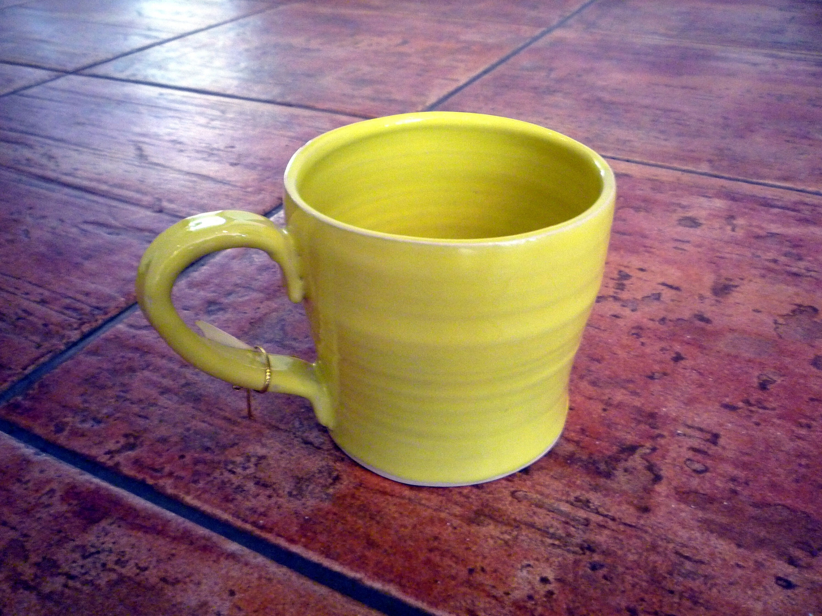
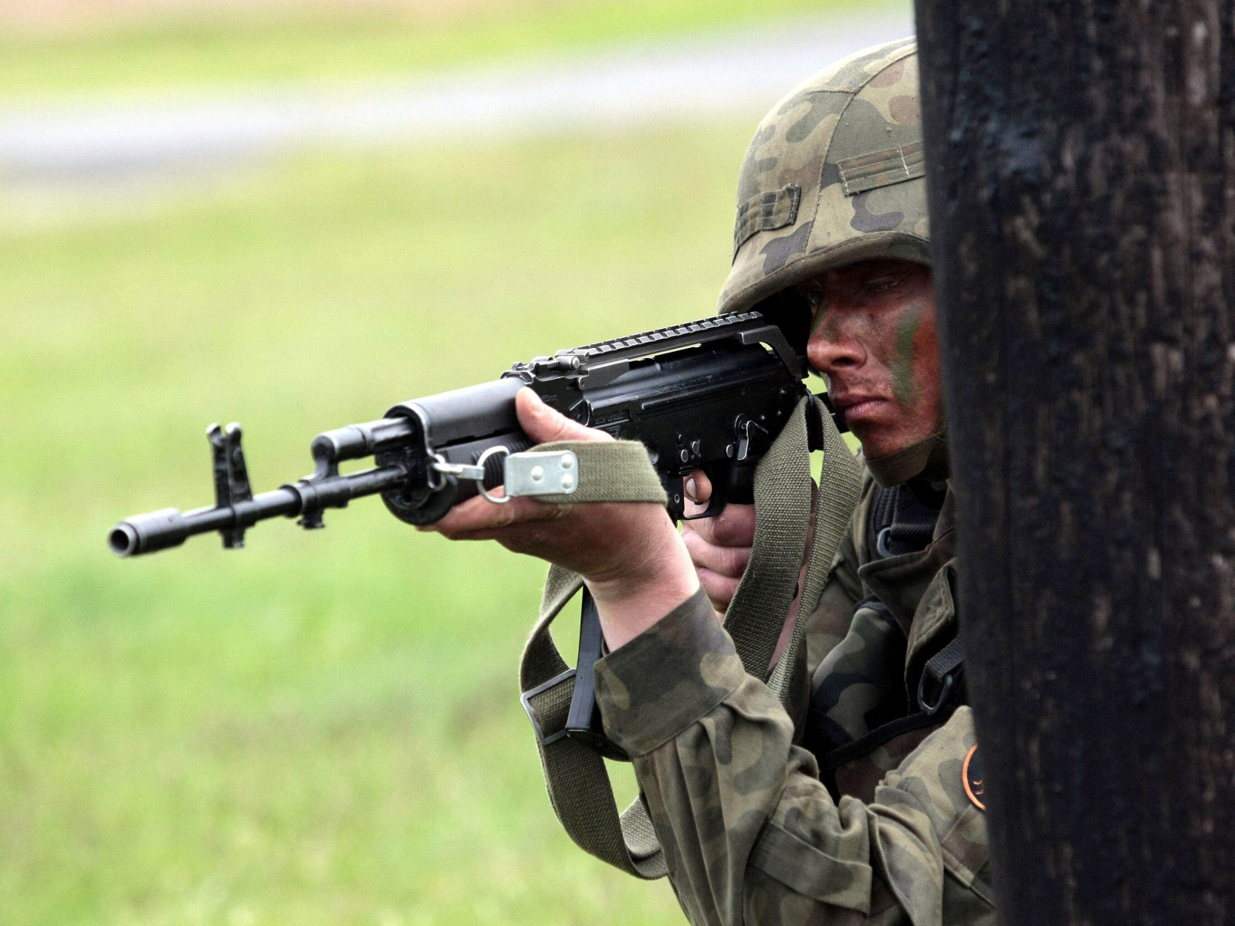
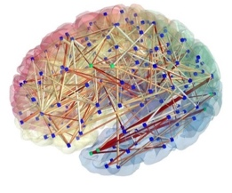
fMRI Protocol
Anatomical Scan
Free Recall Task
Positive Scenario
Mundane Scenario
Traumatic/Stressful Event
Response Inhibition Task
Emotional Go/No-Go
Happy, Neutral, Angry Facial Expressions
Visual Reminders Task
Positive, Neutral, Trauma-Specific
Military/Combat, MVA, Interpersonal/Sexual
Free Recall Task
Traumatic/Stressful Event
Resting-State Scan
Notes:
\

Slide 6
Sample Characteristics
9 Participants:
7 Healthy Controls
2 PTSD Patients (Interpersonal Violence)
Mean Age: 32 years (Range 23-45)
Gender Distribution: 67% (6) Males, 33% (3) Females
Race: 67% (6) White, 33% (3) Asian
Subject ID | Age | Gender | Condition | Hispanic/ Latino | Race
1783 | 45 | Female | Healthy | No | White
1784 | 36 | Female | Healthy | No | Asian
1807 | 23 | Male | Healthy | No | White
1808 | 28 | Male | Healthy | No | White
1811 | 30 | Female | PTSD | No | Asian
1809 | 43 | Male | Healthy | No | White
1820 | 31 | Male | PTSD | No | White
1819 | 26 | Male | Healthy | No | Asian
1830 | 28 | Male | Healthy | No | White
Notes:
Accordingly, recent innovative work by Stevens et al. (2021) aimed to discover brain-based biotypes of trauma resilience and psychopathology in the acute aftermath of trauma, using data from the AURORA longitudinal study of trauma survivors.
3 weeks after trauma, participants engaged in fMRI tasks that were simple in their design and interpretation and that have been widely used to probe threat, reward, and response inhibition.
In the Threat Task, average activations of the Amygdala, Insula, dACC and sgACC were examined in response to fearful vs. neutral faces
In the Reward Task, average activations of the NAcc, Amygdala and OFC were examined in response to monetary gain vs. loss
In the Inhibition Task, average activations of the Amygdala and vmPFC were examined in response to no-go vs. go (correct) trials
These 9 measures of average activations to different fMRI tasks were entered into a hierarchical clustering analysis, to identify brain-based groupings of individuals. This is a bottom-up method designed to preserve the existing structure of the data without imposing
assumptions of linearity, appropriate for exploratory analysis.

Slide 7

Data Summary
Anatomical Scan V 9/9
Free Recall Task V 9/9
Positive Scenario
Mundane Scenario
Traumatic/Stressful Event
Response Inhibition Task V 9/9
Emotional Go/No-Go
Happy, Neutral, Angry Facial Expressions
Visual Reminders Task V 9/9
Positive, Neutral, Trauma-Specific
Military/Combat, MVA, Interpersonal/Sexual
Free Recall Task V 7/9
Traumatic/Stressful Event
Resting-State Scan V 7/9
Notes:
Accordingly, recent innovative work by Stevens et al. (2021) aimed to discover brain-based biotypes of trauma resilience and psychopathology in the acute aftermath of trauma, using data from the AURORA longitudinal study of trauma survivors.
3 weeks after trauma, participants engaged in fMRI tasks that were simple in their design and interpretation and that have been widely used to probe threat, reward, and response inhibition.
In the Threat Task, average activations of the Amygdala, Insula, dACC and sgACC were examined in response to fearful vs. neutral faces
In the Reward Task, average activations of the NAcc, Amygdala and OFC were examined in response to monetary gain vs. loss
In the Inhibition Task, average activations of the Amygdala and vmPFC were examined in response to no-go vs. go (correct) trials
These 9 measures of average activations to different fMRI tasks were entered into a hierarchical clustering analysis, to identify brain-based groupings of individuals. This is a bottom-up method designed to preserve the existing structure of the data without imposing
assumptions of linearity, appropriate for exploratory analysis.

Slide 8
1. Visual Reminders Task
30 Blocks – 10 Positive, 10 Neutral, 10 Trauma-Specific (counterbalanced)
Each Block – 8 images * 2s each (16s)
Between Blocks – Rate “How do you feel right now?”
Scale from 1 (unpleasant) to 9 (pleasant) (10s)
Neural Analysis – Block Design
Contrasts
Positive vs. Neutral
Trauma vs. Neutral
Positive vs. Trauma

Slide 9
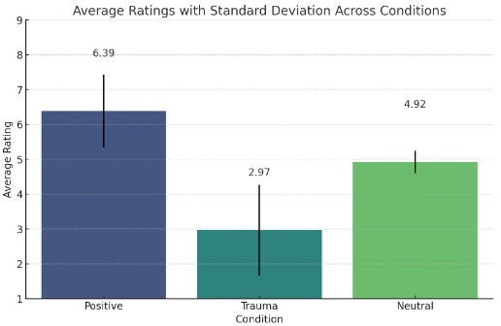
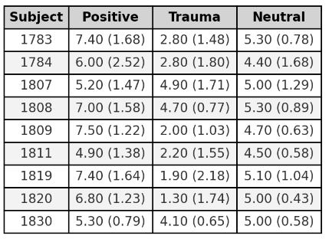
1. Visual Reminders – Behavioral Results
As expected, across all subjects (n=9), Positive blocks were more pleasant than Neutral blocks, which were more pleasant than Trauma blocks (One-way ANOVA, F=27.51, p<0.001)
Average Rating (Average RT) Per Condition

Slide 10
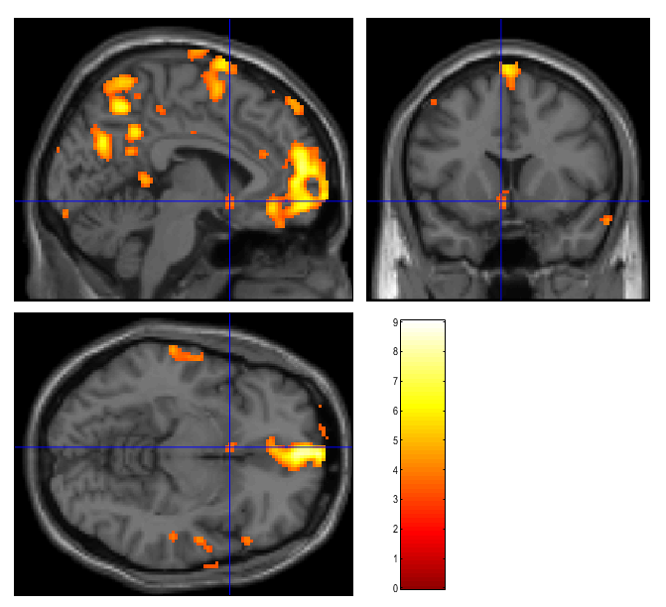
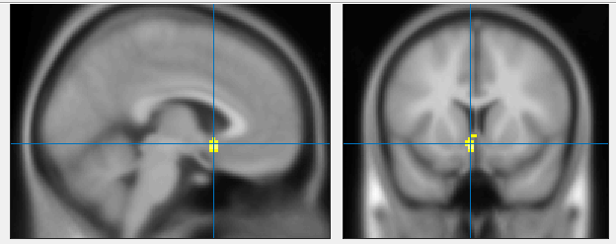
1. Visual Reminders – Neural Results
Single Subject, Positive vs. Neutral
Whole-brain, p=0.001 (uncorrected)
Whole Brain
Left Ventral Striatum

Slide 11
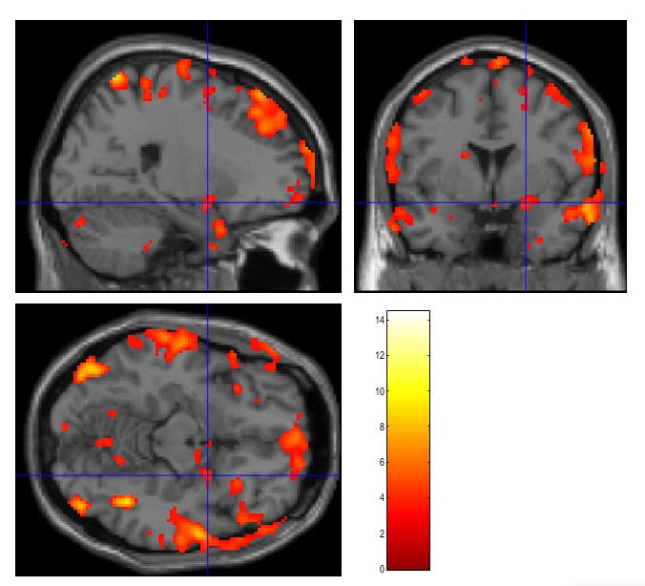
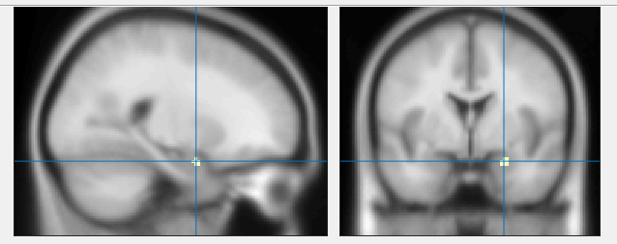
1. Visual Reminders – Neural Results
Single Subject, Trauma vs. Neutral
Whole-brain, p=0.001 (uncorrected)
Whole Brain
Right Amygdala

Slide 12
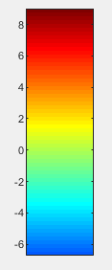
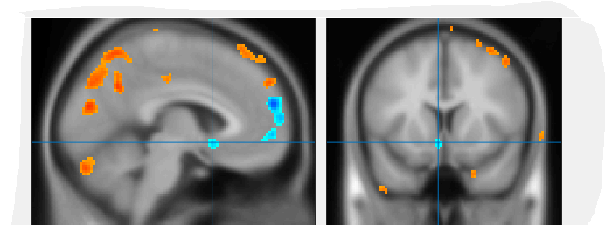
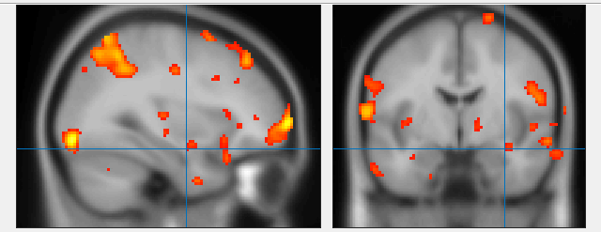
1. Visual Reminders – Neural Results
Single Subject, Trauma vs. Positive
Whole-brain, p=0.001 (uncorrected)
Hyper-active Amygdala
Hypo-active Ventral Striatum

Slide 13
2. Response Inhibition Task
6 Different Blocks (each 24 images)
Angry-Happy, Happy-Angry
Angry-Neutral, Neutral-Angry
Happy-Neutral, Neutral-Happy
Total of 144 Trials – 2/3 Go Trials (96), 1/3 No-Go Trials (48)
Between Blocks – Instructions (10s)
Behavior – Accuracy, Reaction Time
Neural Analysis – Event-related Design
Contrasts
Go vs. No-Go
Specific Emotions (Angry, Happy, Neutral)
Gender (Male vs. Female)
Notes:
Here, using this similar dataset of recent trauma survivors and closely matched analytic processes, we aimed to examine whether the previously identified brain-based clusters can generalize to our independent sample of trauma survivors.
If replicated, we aimed to test whether a cluster characterized by heightened reactivity to both threat and reward would be similarly associated with increased subsequent symptoms of PTSD and anxiety, thus demonstrating the stability of a biological phenomenon across similar measures of psychopathology.
I wish to thank Dr. Stevens and highlight the successful collaboration, which is not trivial. This includes full details of the neuroimaging data preprocessing & analysis steps, and sharing with me the regions of interest and code for clustering analysis.

Slide 14
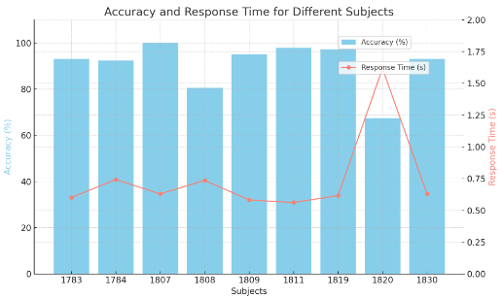
2. Response Inhibition - Behavioral Results
Accuracy (%): M=90.74, SD=10.38, Range 67.36-100
Response Time (sec): M=0.746, SD=0.333, Range 0.562-1.618
Subject ID | Accuracy (%) | Reaction Time (sec)
1783 | 93.08 | 0.601
1784 | 92.36 | 0.743
1807 | 100 | 0.630
1808 | 80.55 | 0.736
1809 | 95.14 | 0.582
1811 | 97.92 | 0.562
1819 | 97.22 | 0.616
1820 | 67.36 | 1.618
1830 | 93.06 | 0.630
Accuracy for all trials per condition (Angry, Happy, Neutral)
Response Time (sec) for Go-Trials per condition (Angry, Happy, Neutral)

Slide 15
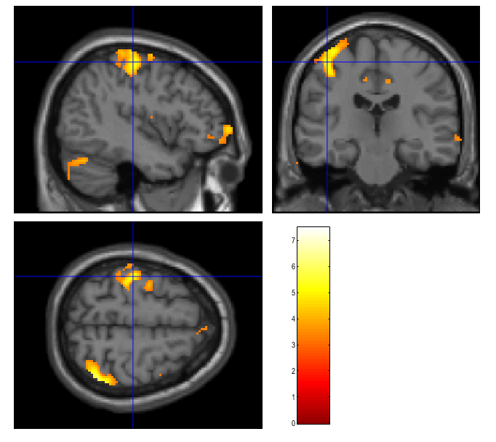
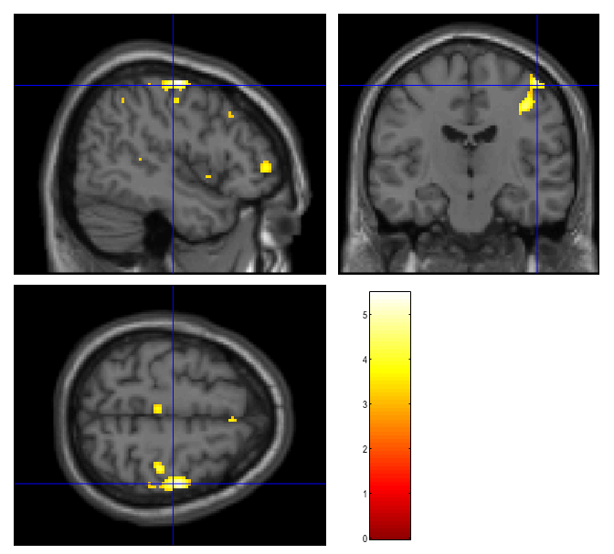
2. Response Inhibition – Neural Results
Single Subject, Go > No-Go (across all trials)
Whole-brain, p=0.001 (uncorrected)
Right-handed Subject
Left Motor Cortex
Left-handed Subject
Right Motor Cortex

Slide 16
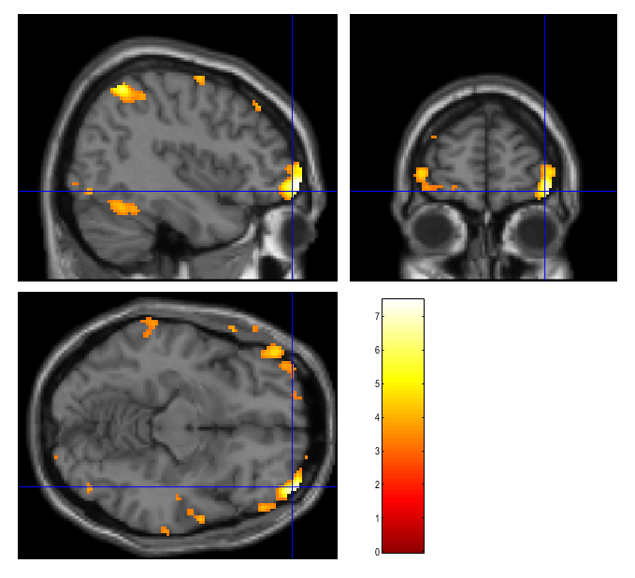
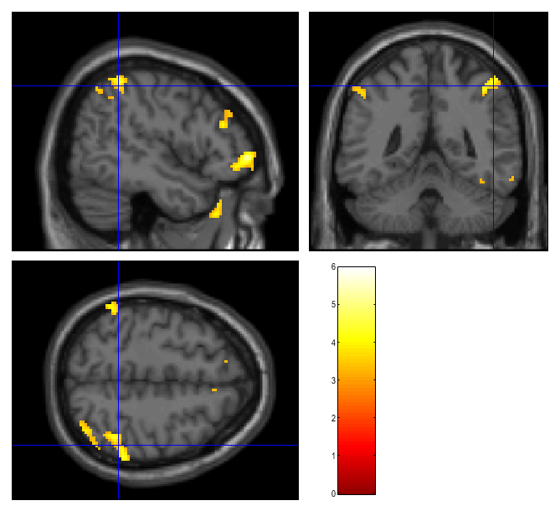
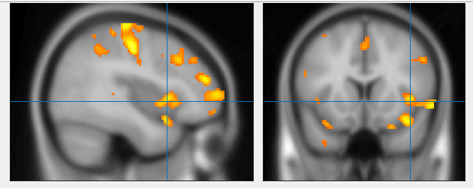
2. Response Inhibition – Neural Results
Single Subject, Go > No-Go (across all trials)
Whole-brain, p=0.001 (uncorrected)
Bilateral Lateral
Orbitofrontal Cortex
Bilateral
Parietal Cortex
Right Insula
Analysis per condition (Angry, Happy, Neutral)

Slide 17
3. Free Recall Task
Average | 3:28 | 2:23 | 3:24 | 3:09
Subject ID | Positive | Mundane | Traumatic #1 | Traumatic #2
1783 | 2:14 | 1:41 | 2:49 | X
1784 | 2:49 | 1:10 | 1:43 | X
1807 | 2:03 | 1:27 | 1:35 | 1:37
1808 | 4:39 | 4:28 | 2:53 | 2:17
1811 | 1:55 | 0:53 | 2:12 | 1:46
1809 | 3:34 | 2:55 | 3:50 | 4:05
1820 | 0:51 | 0:48 | 2:34 | 1:46
1819 | 6:17 | 5:00 | 6:51 | 4:35
1830 | 6:56 | 3:11 | 6:16 | 6:00

Slide 18
3. Free Recall Task – Behavioral Results
Post-Recall Feeling: Mundane (5.6) > Positive (4.9) > Trauma (3.4)
Memory Vividness: Trauma (6.6) > Positive (6.4) > Mundane (5.8)
"How vivid was the memory?"
Not Vivid At All (0) to Extremely Vivid (9)
"How do you feel right now?"
Unpleasant (0) to Pleasant (9)

Slide 19
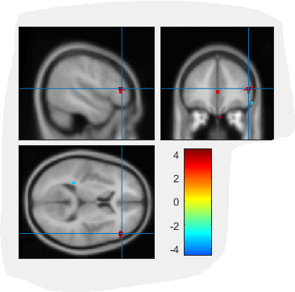
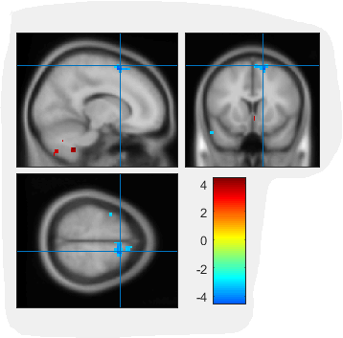
3. Free Recall – Neural Results
Brain connectivity patterns during Traumatic/Stressful recall
Whole-Brain Seed-to-Voxel Analysis (p<0.001 uncorrected)
Seed – Left Hippocampus: positive functional connectivity with right Inferior Frontal Gyrus, and negative functional connectivity with bilateral Superior Frontal Gyrus.

Slide 20
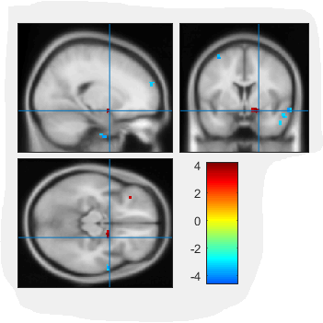
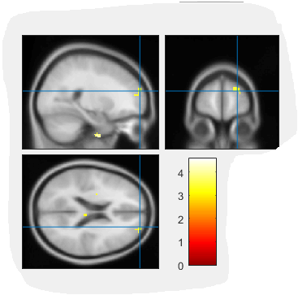
3. Free Recall – Neural Results
Brain connectivity patterns during Traumatic/Stressful recall
Whole-Brain Seed-to-Voxel Analysis (p<0.001 uncorrected)
Seed – right Hippocampus: positive functional connectivity with right Amygdala, and negative functional connectivity with bilateral Superior Frontal Gyrus.

Slide 21
Part 2:
fMRI Analysis Pipeline –
from raw DCM files to activation maps

Slide 22
fMRI Analysis Pipeline
Data Preparation
Preprocessing (fMRIprep)
First-level Analysis
Second-level Analysis

Slide 23
fMRI Analysis Pipeline #1 – Data Preperation
Verify behavioral & neural files for each subject:
Structural (MPRAGE) scan (176 DCMs)
Emotional Go-No-Go task (≈816 DCMs) + behavioral file
Visual reminders task (≈862 DCMs) + behavioral file
Free recall scan (variance in the number of DCMs)
Create an organized list of subjects and data
Included/excluded subject, missing/incomplete data + why?
DCM to NifTi conversion + Visual QC
Dcm2nii toolbox (https://www.nitrc.org/projects/dcm2nii/)
DCM/NifTi to BIDS conversion
“convertBIDS” script (Lab’s GitHub) or other tools (https://bids.neuroimaging.io/)
Upload to server
Globus file transfer (https://docs.ycrc.yale.edu/data/globus/)

Slide 24
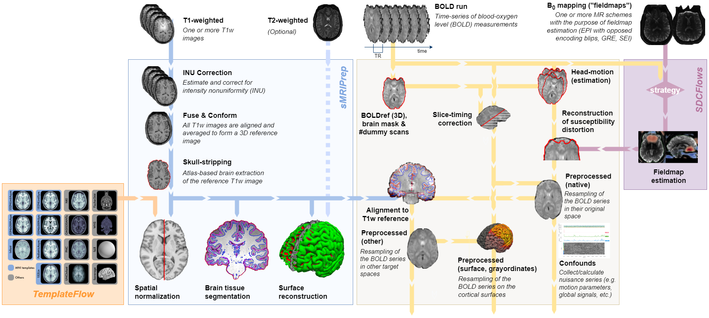
fMRI Analysis Pipeline #2 – Preprocessing
fMRIPrep: A robust preprocessing for task-based and resting-state fMRI data (https://fmriprep.org/en/stable/)
Lab’s Github → “pipeline” repository → “fmriPrep” folder → “FmriPrep_singularity.sh” script

Slide 25
fMRI Analysis Pipeline #2 – Preprocessing
Run fMRIprep pipeline on all subjects
“FmriPrep_singularity.sh” script (Lab’s Github)
fMRIprep Quality Control (MRIQC reports for each subject)
Update tasks configuration scripts
“GoNoGo_Configuration” script
“VisualReminders_Configuration” script
Perform spatial smoothing to enhance data quality by reducing noise and artifacts.
“spatialSmoothing” script

Slide 26
fMRI Analysis Pipeline #3 – First-level Analysis
Create an “event file” for each subject, for each task (condition, onset, duration)
“convert_csv_to_mat” script
Run the first-level analysis (single-subject level)
“firstLevelAnalysis” script

Slide 27
fMRI Analysis Pipeline #4 – Second-level Analysis
Create the relevant contrasts of interest for each task
“createContrasts” script
Run the second-level analysis (group-level)
“secondLevelAnalysis” script

Slide 28
Part 3:
Functional Connectivity Analysis –
CONN Toolbox

Slide 29

Brain Functional Connectivity
CONN: MATLAB-based functional connectivity toolbox
Many different connectivity analyses: seed-based correlations, ROI-to-ROI graph analyses, ICA, masked ICA, fc-MVPA, generalized PPI, ALFF, ICC, GCOR, LCOR, etc.
Simple-to-use (but still needs interpretation…)
Covers the entire pipeline from raw data (but can also work with processed data)
Good for both resting-state and in-task connectivity
Website: https://web.conn-toolbox.org/
Free Download: https://www.nitrc.org/projects/conn
Requirements:
Mac/Windows/Linux/HPC
Matlab & SPM

Slide 30
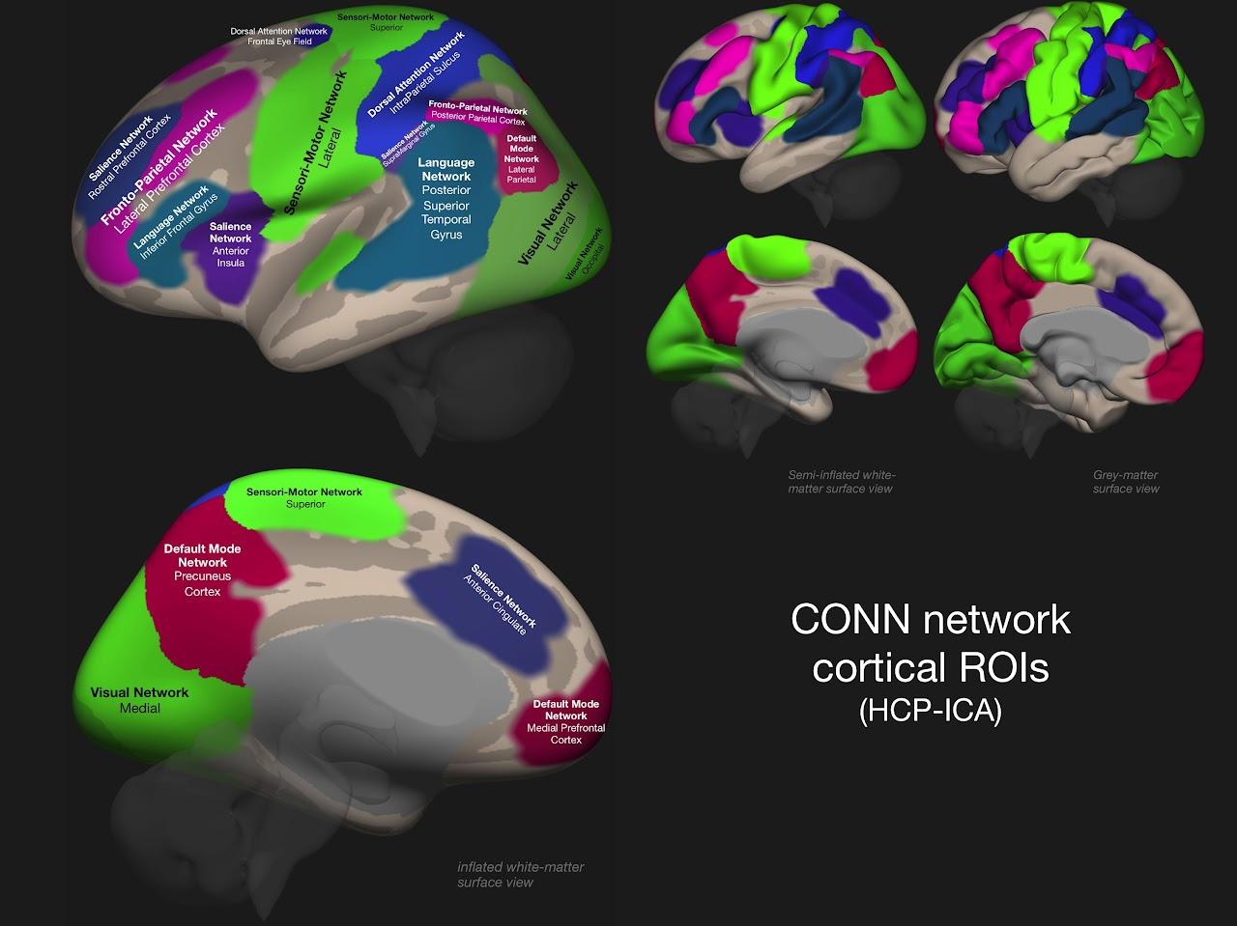
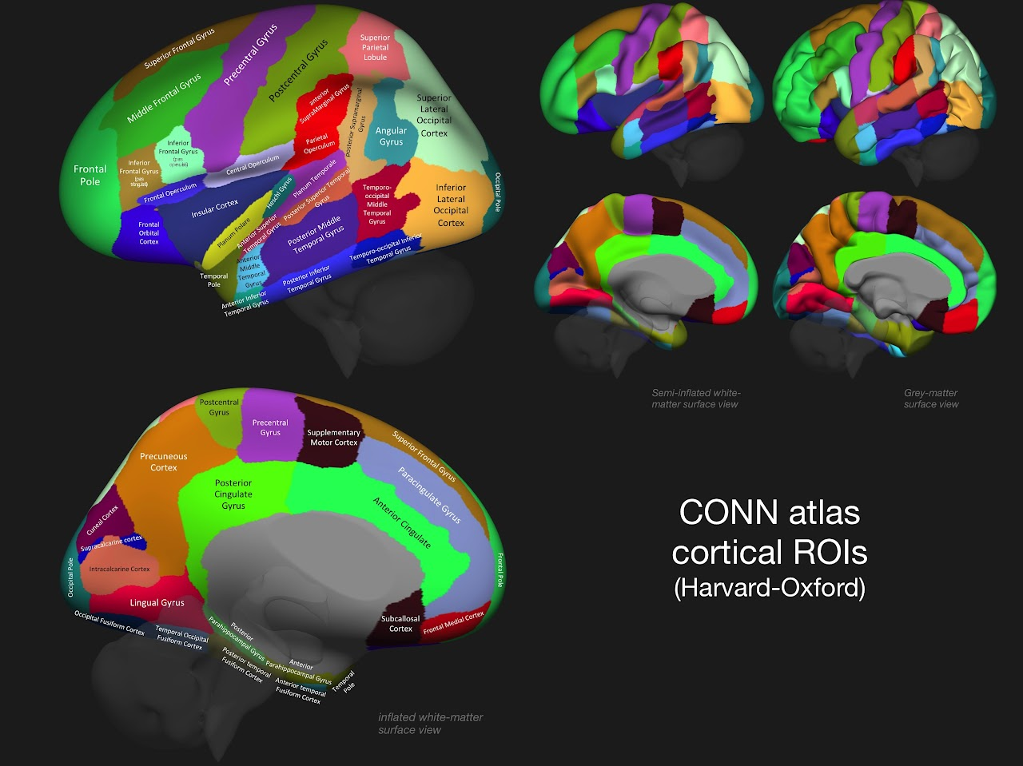
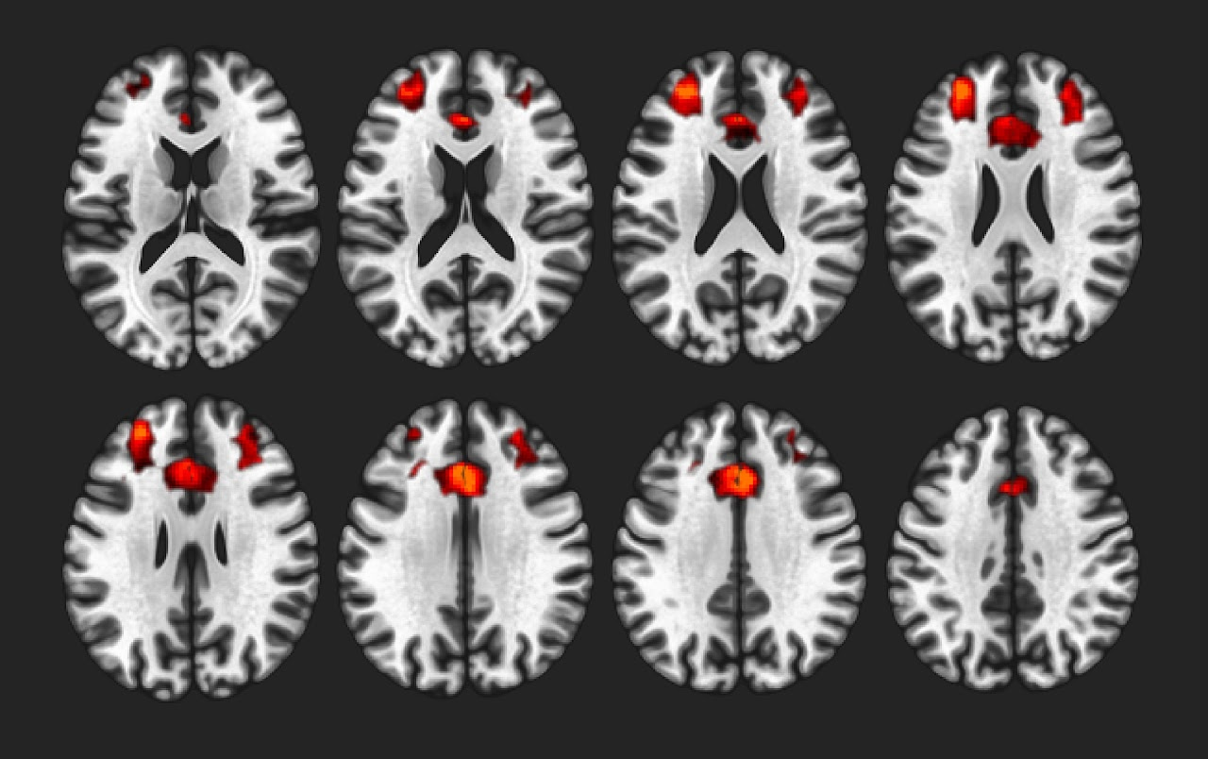
Brain Functional Connectivity (CONN Toolbox)
8 Different ICA Networks
Salience Network, ACC & PFC components

Slide 31
Brain Functional Connectivity (CONN Toolbox)
Detailed manual
(https://web.conn-toolbox.org/resources/documentation/manual)
Andy’s brain book (https://andysbrainbook.readthedocs.io/en/latest/FunctionalConnectivity/CONN_ShortCourse/CONN_04_GUI_Overview.html)
NITRC forum
(https://www.nitrc.org/forum/forum.php?forum_id=1144)

Slide 32
Thank you!
Discussion / Q&A / Other Cool Stuff

